Slide 1
To find missing person using AI
Group number:- 13
Group Members:-
SHUBHneet Choudhary(1900820100146)
Shahnawaz Khan(1900820100133)
Shivkant tyagi(1900820100140)
priyanshi Varshney(1900820100110)

Slide 2
Modules:-
Home Page
Register a Missing Person
Report a Missing Person

Slide 3
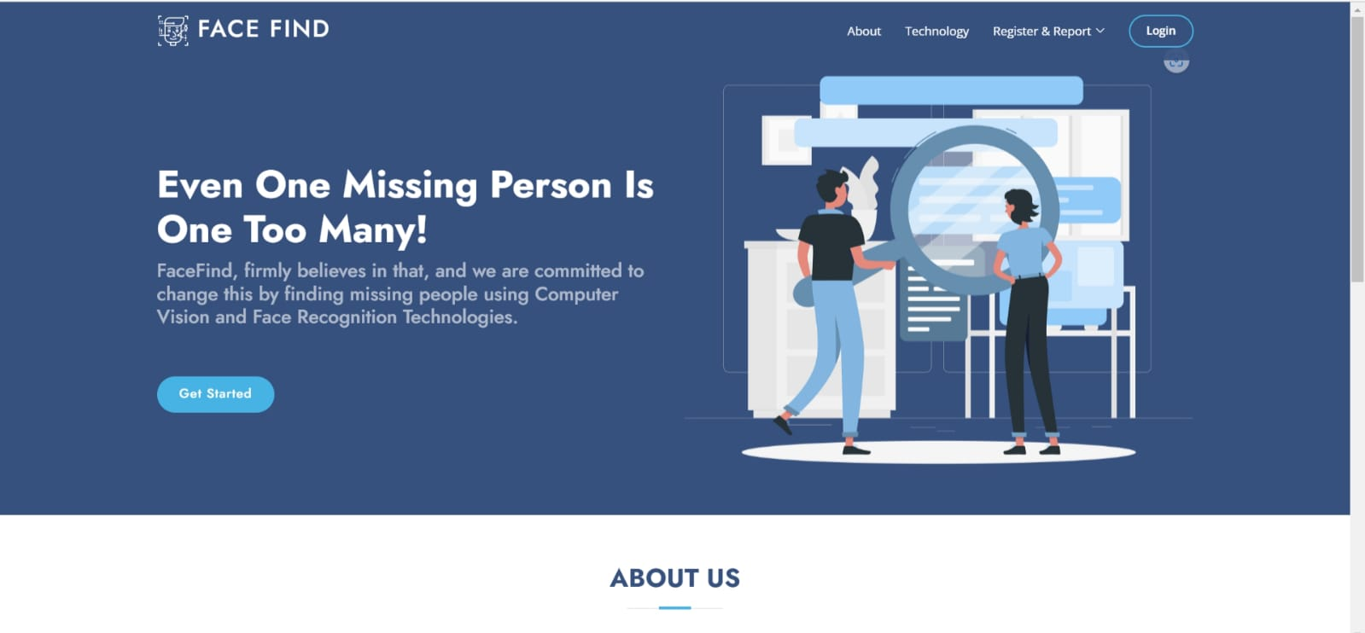
Home Page

Slide 4
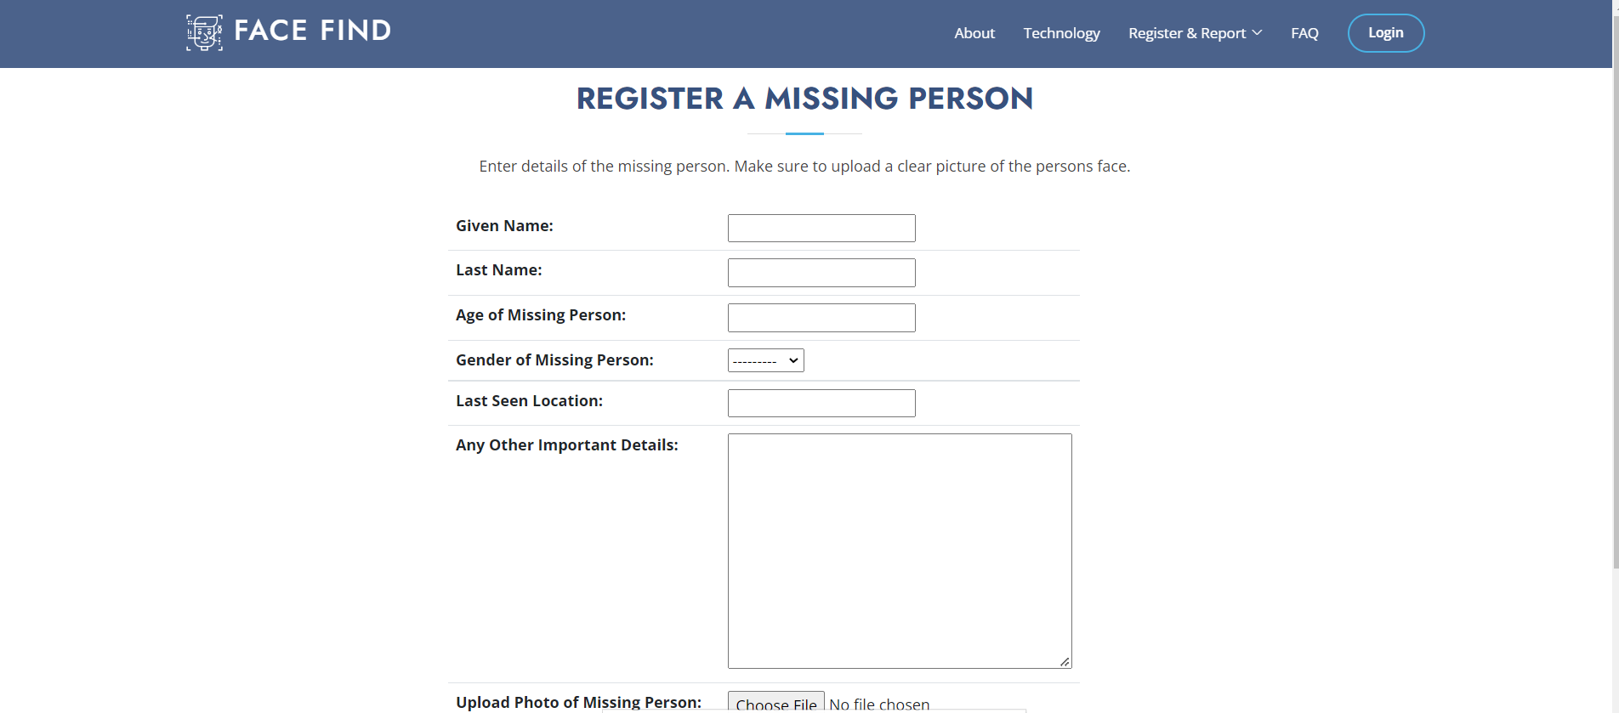
Register a Missing Person

Slide 5
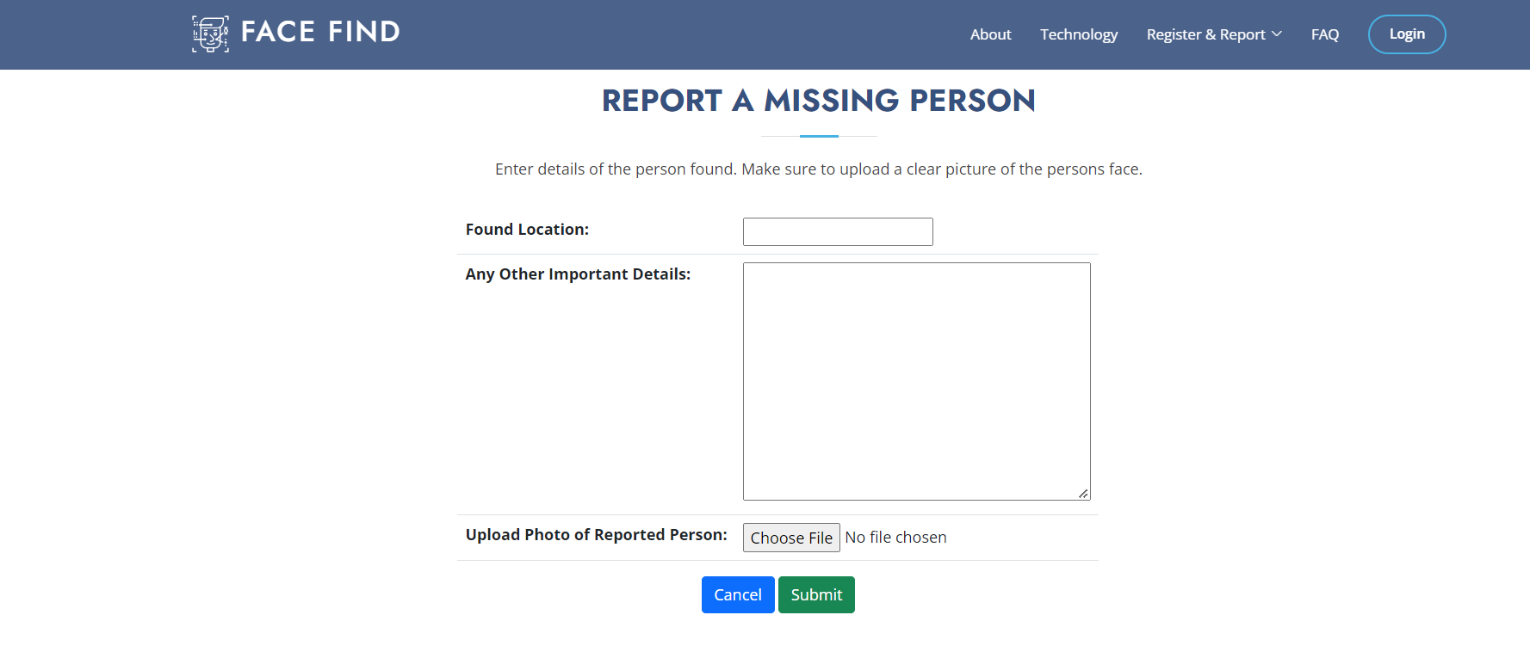
Report a Missing Person

Slide 6
THANK YOU

